Slide 1

Stock Price Prediction
Using
Machine Learning
Kevin Mathew T (BE/10085/17)

Slide 2

Problem Statement
The aim of this project is to examine the effectiveness of Machine Learning to predict future stock prices based on given previous stock prices.
This is achieved with the help of Recurrent Neural Networks, which is a Supervised Learning Model.

Slide 3
Can we predict Stock Prices with
Machine Learning?

Slide 4
Data Points
News
New Launches
Securing of Contracts
Employee Layoffs
Investor Sentiment
Accounting Errors or Scandals
Etc.

Slide 5
Why do top firms hire
Quantitative Analysts to build
Predictive Models?

Slide 6
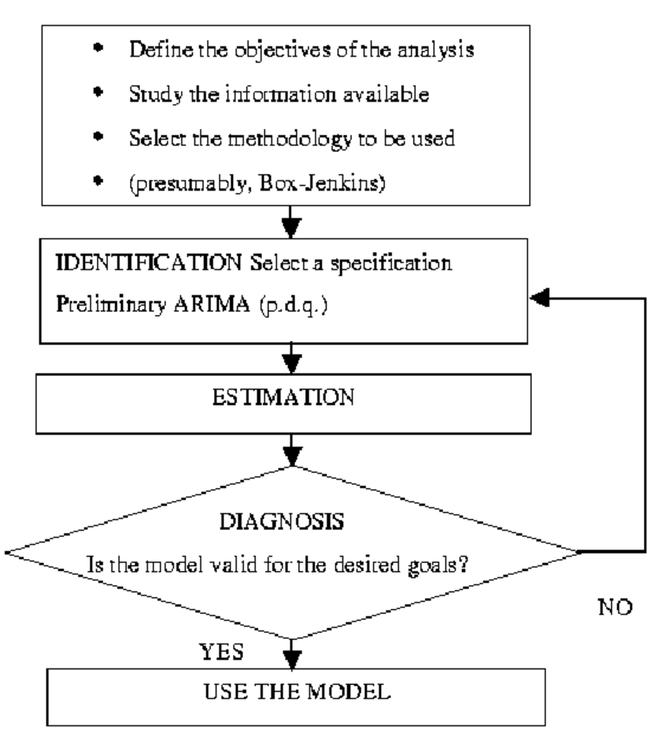
Autoregressive Moving Average (ARMA)
Named after the statisticians George Box and Gwilym Jenkins.
Made in 1970.

Slide 7
Neural Networks
Neural Networks have been commonly used to predict stock prices.
Many academic papers have come out each with varying degrees of success.
Development is limited to academics since coding Neural Networks is very complex.

Slide 8


Slide 9
Why Recurrent Neural Networks?

Slide 10
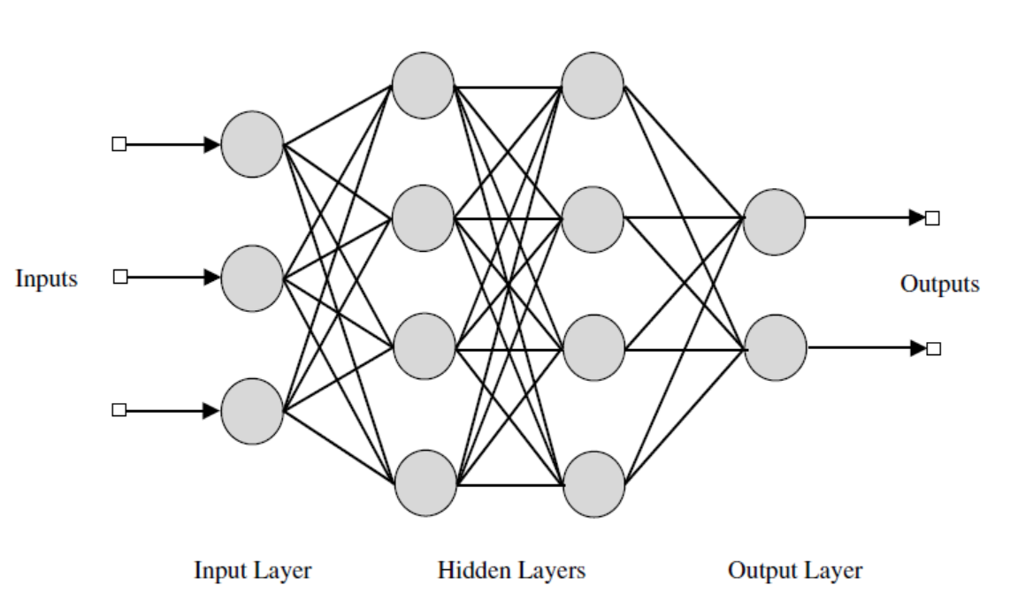
Conditional Memory
Straight - “The quick brown fox jumps over the lazy dog”
Reverse - “Dog lazy the over jumps fox brown quick the”
Feed Forward Neural Networks do not have memory, while Recurrent Neural Networks do.

Slide 11

Recurrent Neural Networks

Slide 12
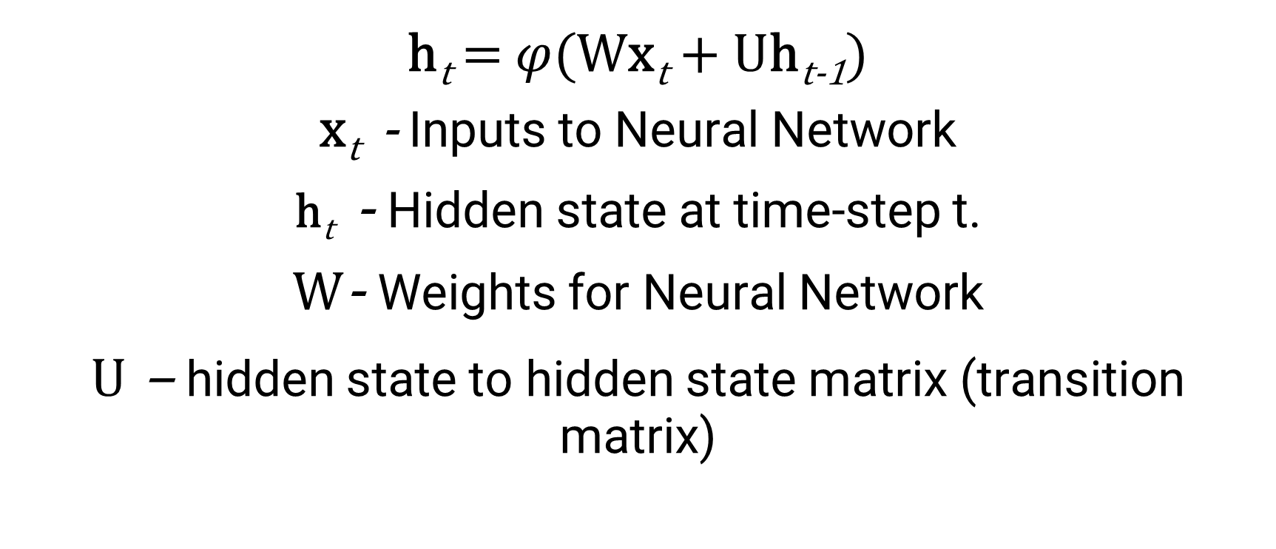
h_{t} = $φ$(Wx_{t} + Uh_{t-1})
x_{t} - Inputs to Neural Network
h_{t} - Hidden state at time-step t.
W- Weights for Neural Network
U – hidden state to hidden state matrix (transition matrix)

Slide 13
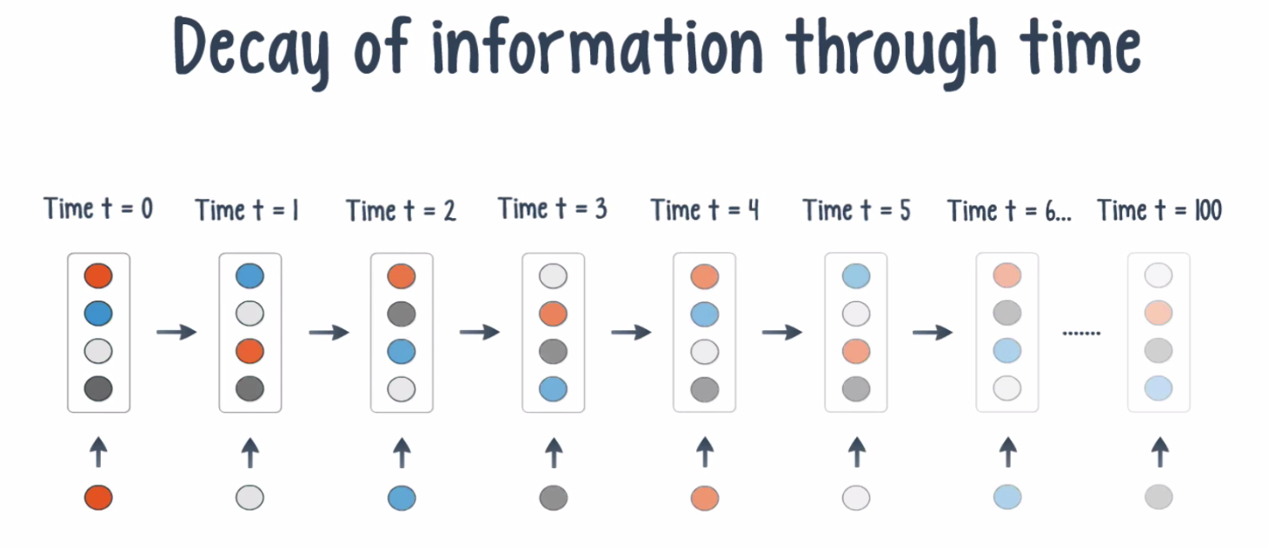
Decay of Information through time

Slide 14
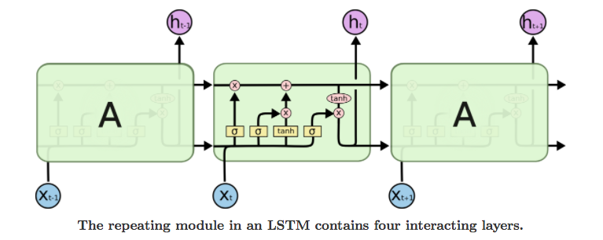
Long Short Term Memory

Slide 15
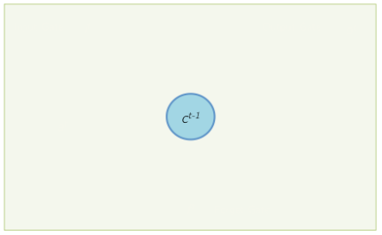

Slide 16
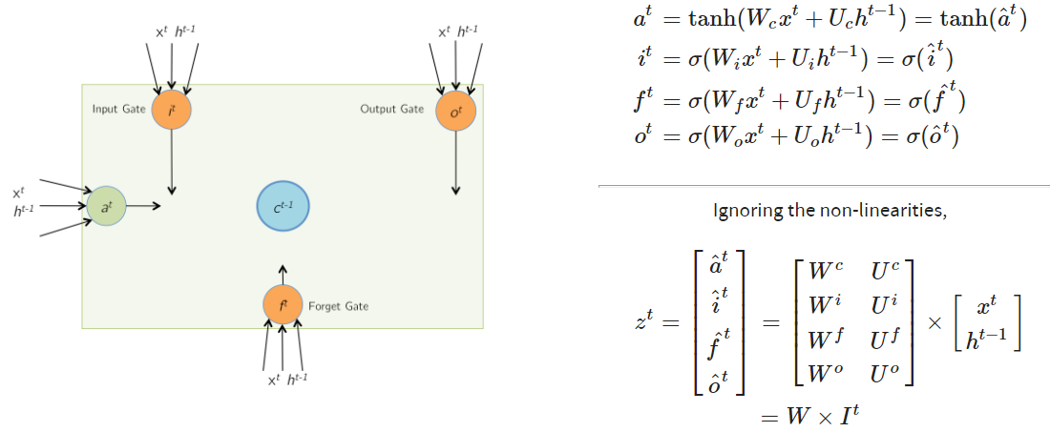

Slide 17
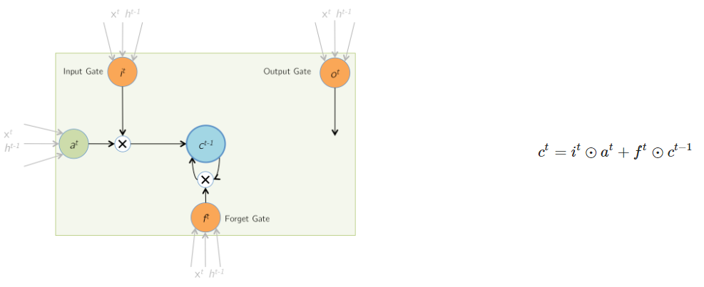

Slide 18
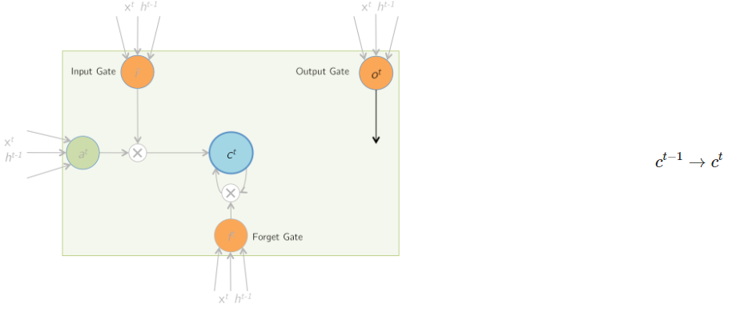

Slide 19
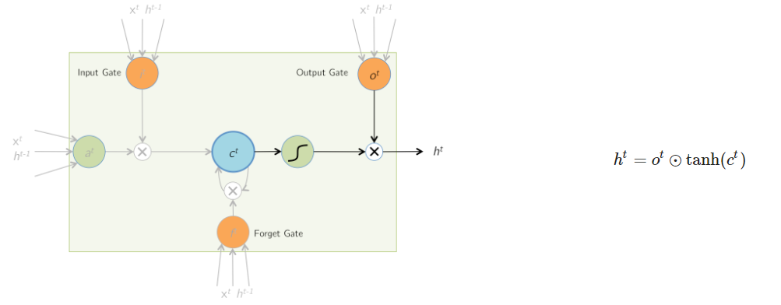

Slide 20
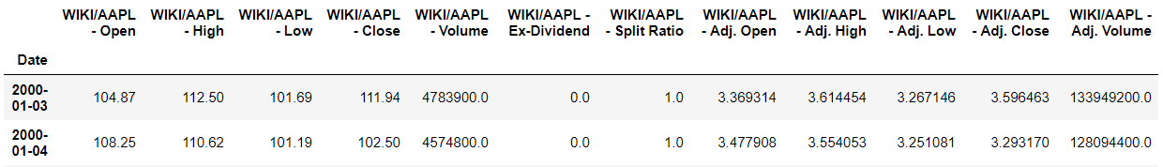
Data Collection
Historical data for the Apple Inc. stock was collected using Quandl.
This data comprised of 13 features of Apple Inc. stocks from 3rd January, 2000 to 27th March, 2018.

Slide 21
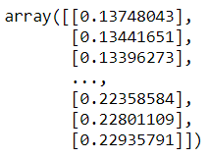
Data Pre-processing
The unrequired features were removed. Only 4 features – Open, High, Low and Close prices for each day were kept.
These features were then shrunk to a single feature known as OHLC which was the average of the four features.
This feature was then scaled across all days using a Min-Max Scaler.

Slide 22
Data Splitting
The data was split into two parts – Training and Testing.
Training dataset consisted of ~80% (3667 days) of the total data, while Testing dataset consisted of the remaining ~20% (918 days).
The model was trained on the Training dataset.

Slide 23
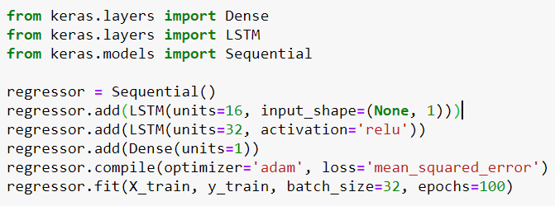
Model

Slide 24
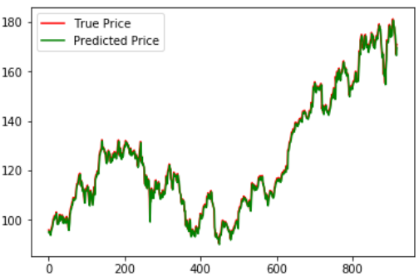
Results
R² score of 0.99534

